Slide 1


Voucher Management System
(VMS)

Slide 2

Introduction
Demonstrating and discussing the current status of the ongoing voucher management system,
Goals of the VMS
Project progress
Current status of the project
Planned initiatives
User interfaces of VMS
Challenges faced
1

Slide 3
Project Objectives
Automate the Voucher management process.
Streamline the creation, approval, printing, distribution, activation and tracking of vouchers and coupons to
improve operation al efficiency and accuracy.
Improve data management and security via digital logs and reports.
Facilitate real-time tracking of voucher statuses from creation to redemption.
Enhance decision making.
Reduce approval delays.
Integration with Existing SLT Systems.
Optimize resource utilization by decreasing cost associated with paper, printing and storage.
3

Slide 4
Functionalities
Create Project
Approve Project
Create batch
Approve batch
Search and view voucher details and vouchers.
Issue batch to print
Voucher distribution management
Activate voucher
Redeem voucher
Track voucher status.
Record sold vouchers.
Generate reports
User management and registraation.
Ensure security

Slide 5
Main Features
Voucher Generation - automated generation of unique voucher codes.
Voucher Approval – streamline approval process.
Voucher Redemption - easy and secure voucher redemption process.
User Management – admin portal for manager user roles, registrations and permissions.
Role based Access Control ( RBAC)
Reporting and Analytics - comprehensive reports on voucher usage and redemption.
Notification System - via SMS and email.
Integration with Existing Systems - seamless integration with ERP systems.
Real time tracking – track the status of vouchers from creation to redemption real-time.
Reporting and Analytics – generate detail reports.
4

Slide 6
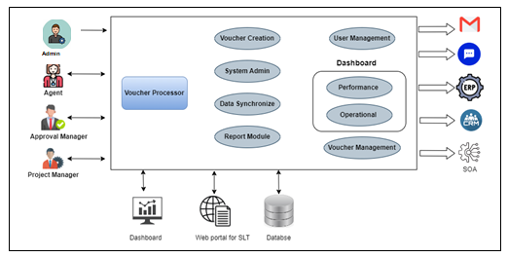
System Architecture

Slide 7
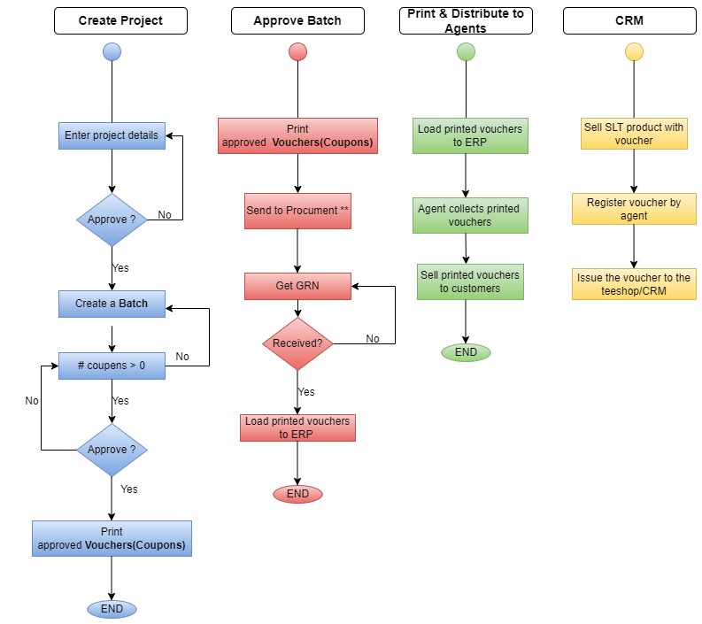
System Workflow
6

Slide 8
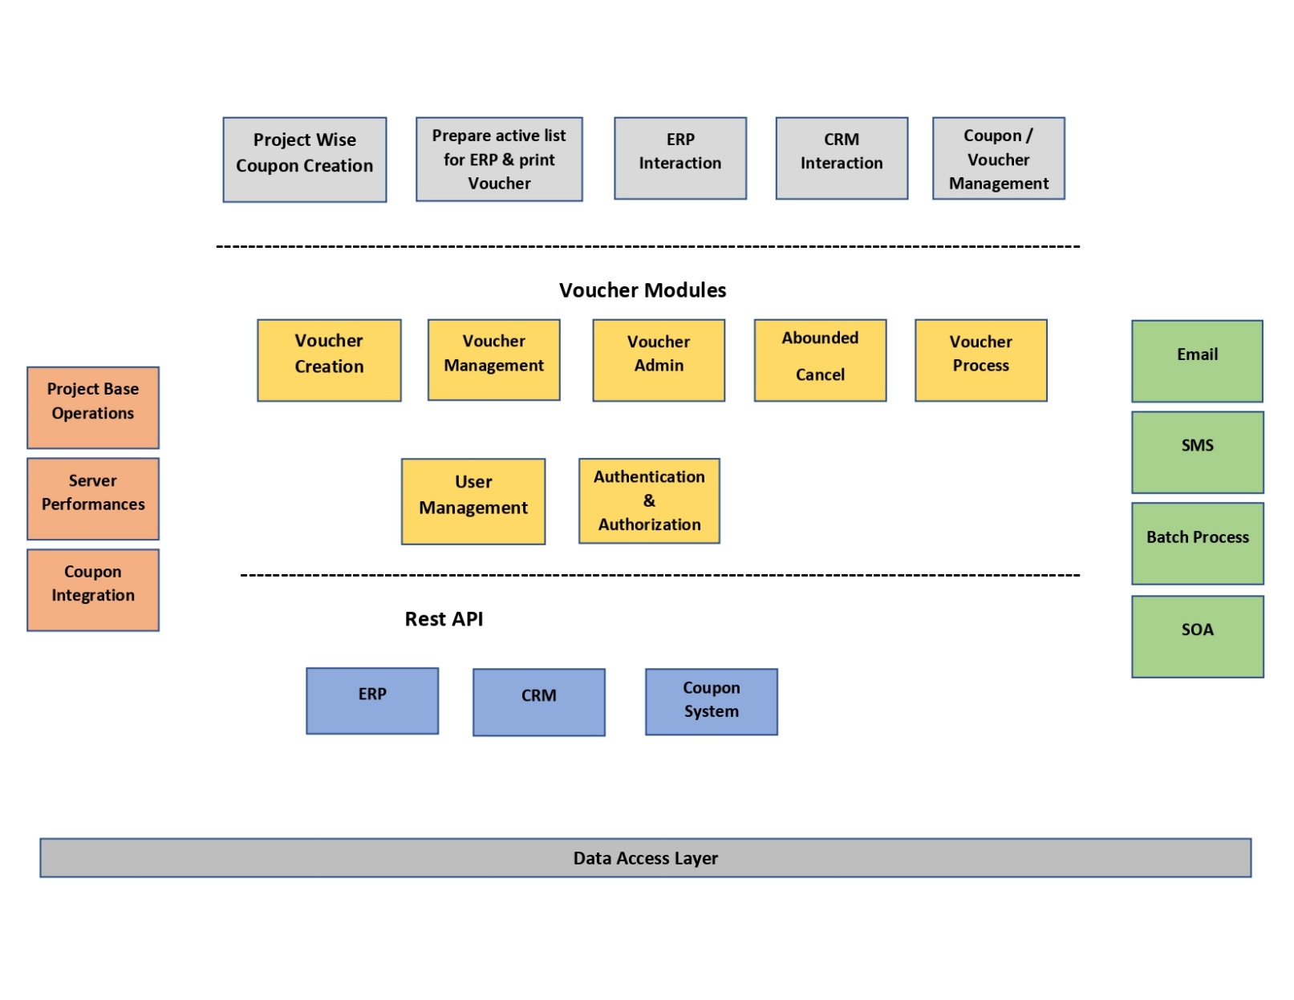
Technical Overview and Architecture
7

Slide 9
Technology Stack
Backend : PHP & Laravel
Frontend : Bootstrap, HTML, JavaScript
Database : MySQL
Authentication : JWT (JSON Web Tokens)
API Documentation : Swagger
Version Control : Bitbucket
8

Slide 10
Project Progress
Requirements gathered and analyzed.
System design and architecture of the system has been planned.
User Interfaces has been completed.
Documentation has been completed.
Initial testing and bug fixes has been done.
Test cases
The front end (web pages) developing is in process.
.
9

Slide 11
Challenges
Integration information is lagging ( ERP, Cashier)
Need for a Server
Need relevant APIs from ERP and CRM to do further development and implementation.
10

Slide 12
User Interfaces
The User Interfaces are created by the UI/UX team using Figma tool during the design phase.
Link :
11

Slide 13
Thank You

